Slide 1
America’s Christian Heritage
Session IV

Slide 2
Not to dampen your mood further
But…

Slide 3
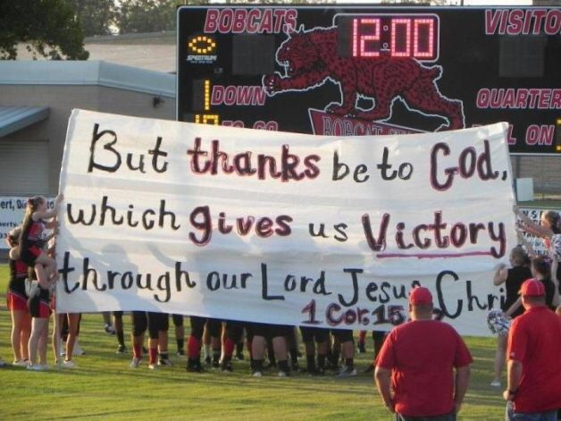
Jane Doe vs Santa Fe Independent School District (2000)

Slide 4
“The court will allow that prayer to be a typical nondenominational prayer, which can refer to God or the Almighty or that sort of thing… The prayer must not refer to… Jesus or anyone else. And make no mistake, the court is going to have a United States Marshall in attendance at the graduation. If any student offends this Court, that student will be summarily arrested and will face up to six months incarceration in the Galveston County Jail for contempt of Court…
Anybody who violates these orders is going to wish that he or she had died as a child when this Court gets through with them.”
The US Supreme Court would subsequently rule that student led prayer at school football games was in fact unconstitutional
(6/3 decision)

Slide 5
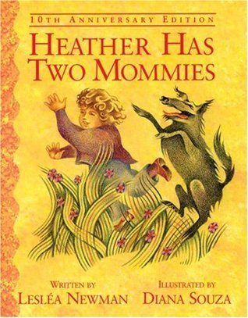
Required Reading in California Elementary Schools

Slide 6
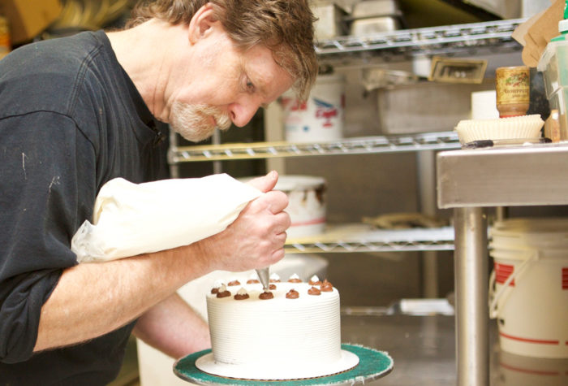
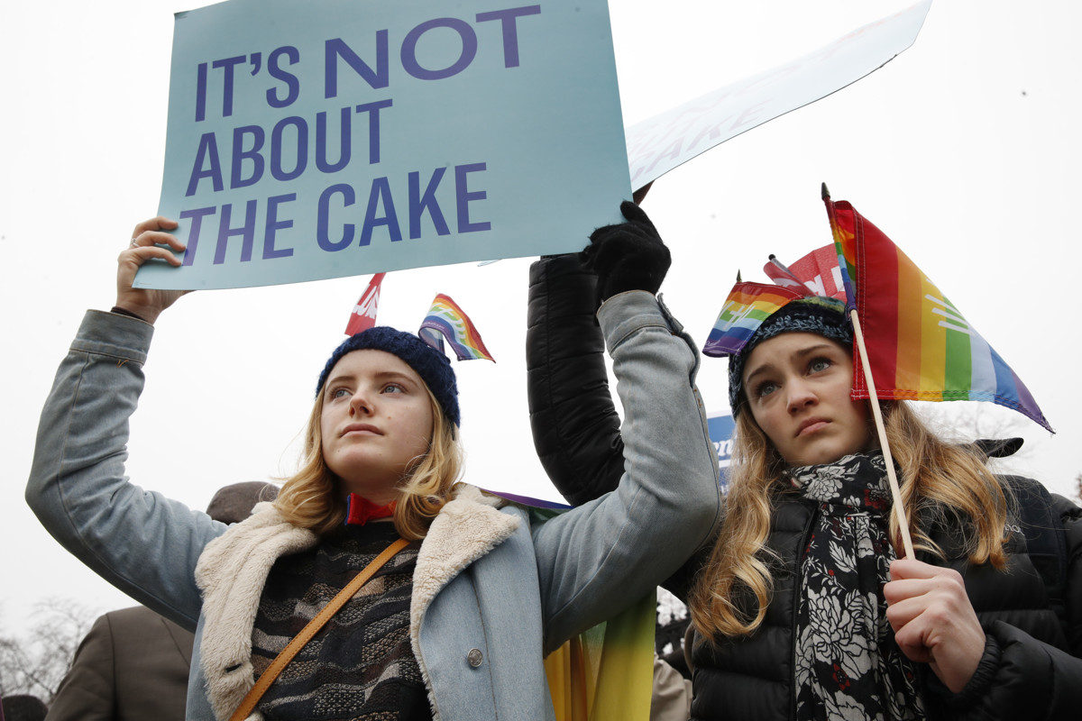
Masterpiece Cakeshop vs Colorado civil rights commission (2018)

Slide 7
How did we get here?

Slide 8
We (believers) have a highly diminished voice in key areas of influence
Anti religious sentiment at various government levels
Anti religious sentiment in our school systems
Anti religious sentiment conveyed through much of the media
Court rulings that are antagonistic towards people of faith
Re-interpreting of the first amendment

Slide 9
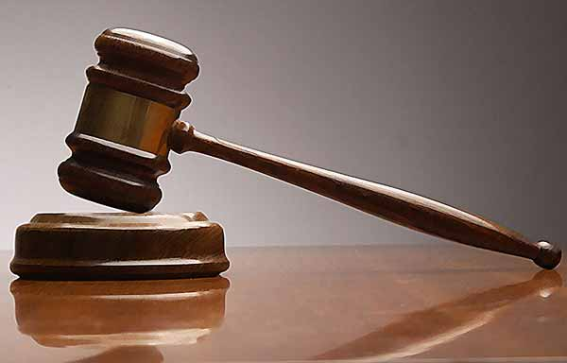
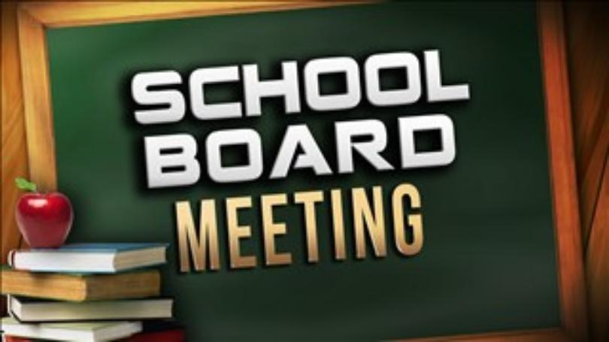
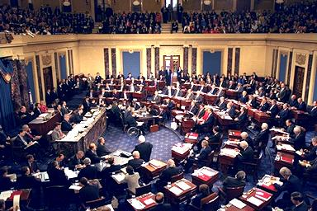
Are We Out-Numbered?
Gallup Poll (125,765 surveyed) throughout all 50 States | As of 2017
Protestant / Other Christian | 48.5%
Catholic | 22.7%
Mormon | 1.8%
Jewish | 2.1%
Muslim | 0.8%
Other Non-Christian | 2.9%
People of Faith Combined | 78.7%
No Religious Identity | 21.3%

Slide 10
“Unfortunately, so many people who share traditionalist viewpoints appear not to know a war is going on. A conflict that will have profound implications on future generations. By contrast, our opponents are highly motivated, well funded, deeply committed and armed to the teeth. This fact becomes inescapable when one examines how issues of importance to the family are decided in government circles.
When hearings are being held in congress on issues of significance to the family, you can be sure the American Civil Liberties Union will be there. Gay rights activists will be there, The National Abortion Rights Action League will be there… But where are our troops? Well, they’re taking care of business back home in Texas, Indiana (or Tennessee). Chances are they won’t even know the issues are being discussed unless some lonely crier spreads the word…

Slide 11
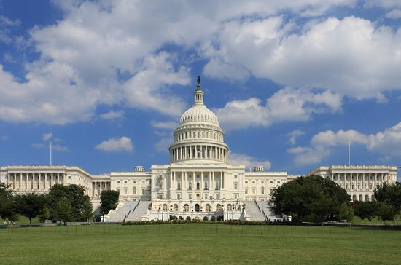
Let me ask you where you were in the mid 70’s when the national debate on parental consent for abortion was held. Did you participate in it? Did you know it was going on? Did you come to Washington to defend your viewpoint? Frankly, I didn’t, because I was like millions of people – like you. I was pre-occupied at home and thought someone else would look out for my interests in national policy. They didn’t. Without this representation, our rights are being stripped from us.”

Slide 12
“I think of these silent defeats every time I hear ministers admonish their congregations to avoid public debates, to leave governmental decisions exclusively in the hands of our elected officials and to avoid unpleasant subjects in the church. If Christians continue to do as these advisors suggest, we will yield the decision making process entirely to the other side by default. We have as much right to influence the system as our philosophical opponents, and we must use the avenues guaranteed to us by the constitution.”

Slide 13
Displacement Theory

Slide 14
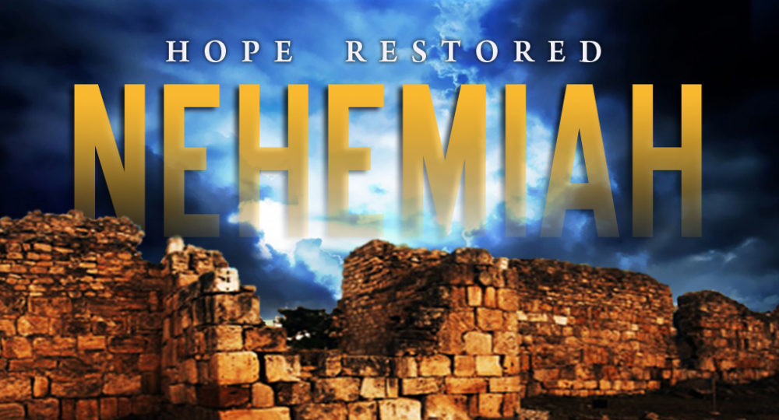
What do we do from here?

Slide 15
“Pray”
“I urge, then, first of all, that petitions, prayers, intercession and thanksgiving be made for all people— for kings and all those in authority…”
(2 Tim 1:1-2)

Slide 16
“Act”
Know Our Story & Our Documents
Seek Influence
Communicate with your Representatives
Vote
Christian Coalition
Eagle Forum
Vote Values
World Magazine
Citizen Magazine
American Family Journal

Slide 17
Don’t lose hope
2 Kings 22
It took decades to get here
We’re seeing some ‘wins’

Slide 18
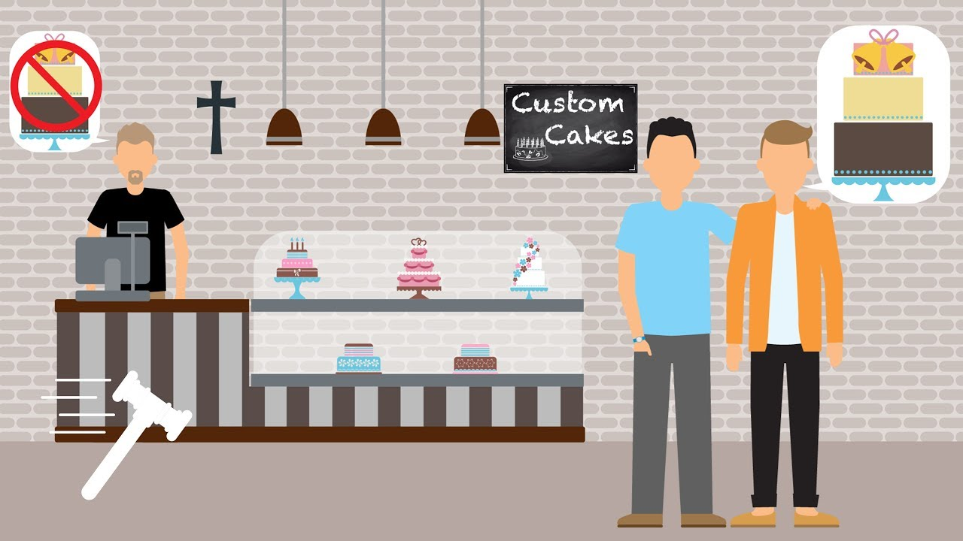

Slide 20
Thank you for participating

Slide 21
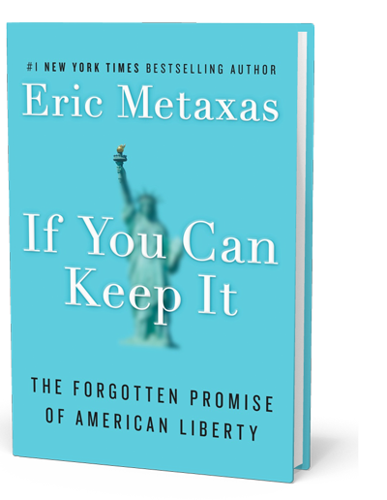
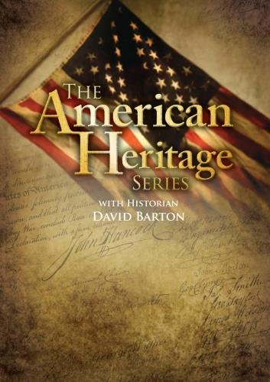
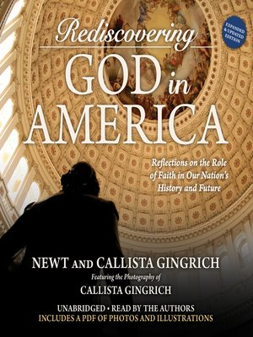
David Barton
Newt Gingrich
Eric Metaxas
Os Guinness

